Slide 1
Is it all about the dollar? Teacher Supply in England, evidence from the LFS, SWC and the DLHE
Joshua J. Fullard
jjfull@essex.ac.uk

Slide 2
Teachers Are Important
Outside of the family unit teachers are the most influential adults in young peoples lives.
There is strong evidence that teachers have a causal effect on:
Educational attainment
Labour market outcomes
Non-cognitive skills (i.e. effort, self-control, confidence, emotional stability)

Slide 3
Four Questions:
Are teachers underpaid?
Do teachers who quit sort into higher paying occupations?
Do wages affect Teacher Supply?
Do wages affect pupil performance?

Slide 4
Are Teacher Underpaid?
Relative to their social/economic contribution
Teacher pay is typically linked with experience not ability
For a given level of experience bad teachers tend to be paid too much and good teachers tend to be paid too little.
Chetty et al. (2011), Hanushek et. al.(2015)

Slide 5
Are Teacher Underpaid?
Compared to what they would have earnt had they not gone into teaching?
Do this by comparing current teachers earnings to the earnings of some non-teacher group such as:
Non-manual occupations
Graduates

Slide 6
Are Teacher Underpaid?
Teachers tend to earn less than the average graduate (~13% less)
Might explain why policy makers struggle to recruit graduates from the top end of the ability distribution
Does not mean current teachers could earn more in a different occupation as teachers differ from graduates on observable and unobservable characteristics

Slide 7
Are Teacher Underpaid?
To get around non-random selection into teaching we use propensity score matching.
Compare teachers to non-teaching graduates who look most like them based on observable characteristics

Slide 8
Are Teacher Underpaid?
Accounting for non-random selection teachers don’t appear to be significantly underpaid (~3% less)
Relative Wages were lowest in the 90’s and since the public sector pay freeze (2010).
Data from 2019 suggests that teachers relative wages may have picked up

Slide 9
Are Teacher Underpaid?
Male Teachers tend to be paid ~15% less than the average male graduate
Accounting for non-random selection they still tend to earn ~10% less

Slide 10
Are Teacher Underpaid?
Female Teachers tend to earn a similar amount to the average graduate
Accounting for non-random selection they earn ~3% more
This might explain why men are far less likely to enter the and more likely to leave the profession

Slide 11
Are Teacher Underpaid?
Teachers initial wages are highly competitive
But grow at a slower rate over the age distribution
If young teachers quit due to pecuniary factors it’s the growth of earnings, not current earnings, that drive this decision

Slide 12
Are Teacher Underpaid?
Teachers initial wages are highly competitive
But grow at a slower rate over the age distribution
If young teachers quit due to pecuniary factors it’s the growth of earnings, not current earnings, that drive this decision

Slide 13
Are Teacher Underpaid?
Our matching strategy matches on observable characteristics
But graduates who sort into teaching clearly differ on unobservable characteristics to non-teaching graduates
Matching current teachers to former teachers reduces the bias driven by unobservable differences

Slide 14
Teachers who quit sort into higher paying occupations?
Teachers who quit tend to sort into similarly paying occupations (~2.5% less)
Using former teachers to estimate current teachers outside option suggests that current teachers earn ~10% more than they would in their outside option

Slide 15
Are Teacher Underpaid?
Teachers earn less than the average graduate
When you account for non-random selection no strong evidence teachers could earn more in their outside option
Teachers initial wages are highly competitive
But grow at a slower rate than the average graduate
Male teachers face a significant wage penalty teaching. Female teachers do not.

Slide 16
Wages and Teacher Supply
Teacher Supply:
Retention of current teachers
Return of qualified teachers who are no longer teaching
Recruitment of graduates into Initial Teacher Training Programmes

Slide 17
Wages and Teacher Supply
Using the LFS and the Destination of Leavers from Higher Education (2003-2012) we exploit the regional variation in teachers relative wages to estimate the effect of wages on the supply of graduates into teacher training programs.

Slide 18
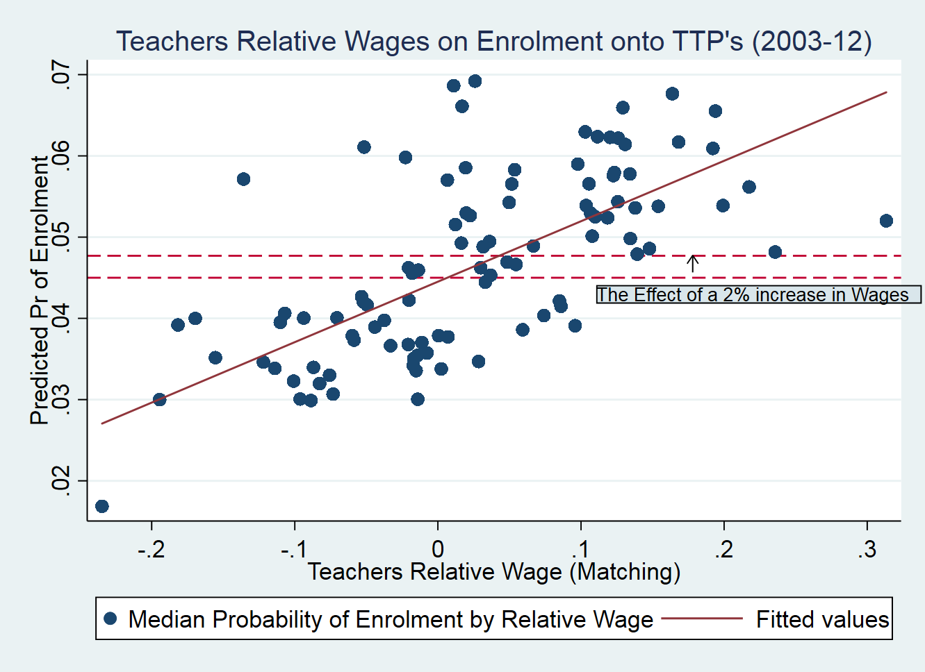
Wages and Teacher Supply
A1sd increase in relative wages increases graduate enrolment onto Teacher Training Programmes by 0.05sd
This is stronger than the effect of teacher training bursaries (0.007sd)
But significantly smaller than the effect of job security (0.12sd)

Slide 19
Wages and Teacher Supply
Do higher wages attract better teachers?
No direct measure of teacher quality
Effect is driven by non-Russell group graduates
Relationship between teachers cognitive skills and pupil performance Hanushek et. al (2019)
Class sizes don’t have a statistically and/or economically significant effect on pupil performance Woessmann and West (2002)
Higher wages are not necessarily welfare improving for pupils
Effect is driven by female graduates and white graduates
Negative effect on teacher diversity

Slide 20
Wages and pupil performance
Estimate the effect of teachers relative wages on pupil performance on grade 4 math and science tests though an efficiency wage model
Use 5 waves of the Trends in International Mathematics and Science Study (1995,2003, 2007, 2011 and 2015) and the LFS to estimate each TIMSS teachers relative wage

Slide 21
Wages and pupil performance
Consistent with our efficiency wage model we find that teachers relative wages are positively associated with Grade 4 pupil performance in England
Data: TIMSS waves 1995,2003, 2007, 2011 and 2015 | Grade 4 Science Scores | Grade 4 Math Scores
Wage Differences | 0.392** | 0.325+
 | (0.199) | (0.205)
Constant | -0.554*** | -0.880***
 | (0.0669) | (0.0611)
n | 24120 | 24120
⁺ p < 0.15, * p < 0.10, ** p < 0.05, *** p < 0.01
Controls include Teacher, School, Student characteristics and year fixed effects. Standard errors are clustered at the class level.

Slide 22
Four Questions:
Are teachers underpaid?
No
Do teachers who quit sort into higher paying occupations?
No
Do wages affect Teacher Supply?
Yes. But the effect size is modest
Do wages affect pupil performance?
Yes

Slide 23
Thank You
Any Questions?
Email: jjfull@essex.ac.uk
Website: https://sites.google.com/view/joshuafullard

